Slide 1
Unit VI File handling Data Hierarchy, Streams and Files https://www.youtube.com/watch?v=hAluLUqaB0s

Slide 2
Introduction
All programs we looked earlier
Input data from keyboard
output data to the screen
Output would be lost as soon as we exit from the program
How do we use secondary storage device
We can use secondary storage devices
Data is packaged up on the storage device as data structures called files

Slide 3
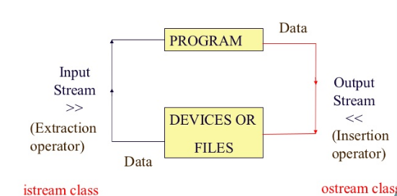
Flow of Data
We give input to the executing program and the execution program gives back the output. The sequence of bytes given as input to the executing program and the sequence of bytes that comes as output from the executing program are called stream.
In other words, streams are nothing but the flow of data in a sequence.

Slide 4
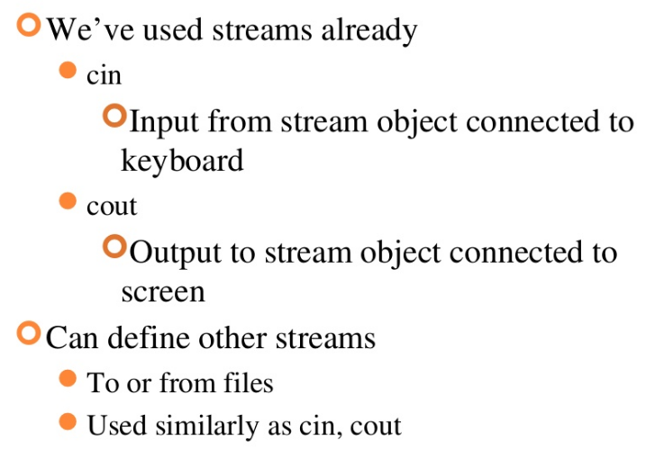
Streams Usage

Slide 5
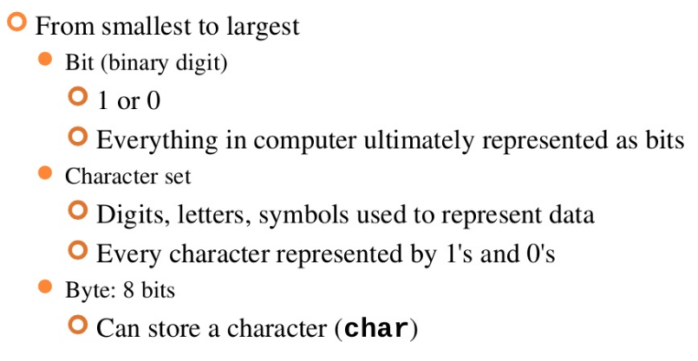
Data Hierarchy

Slide 6
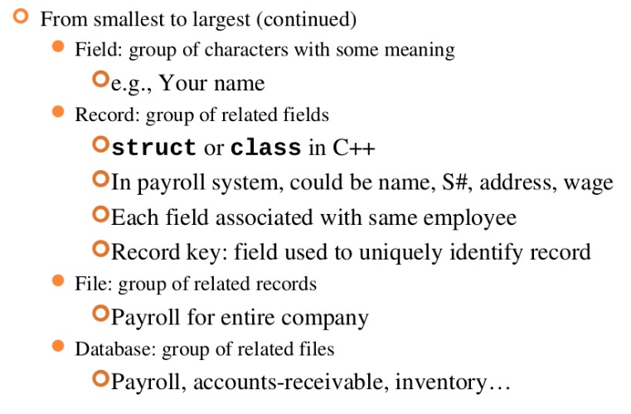
Contd…

Slide 7
The input and output operation between the executing program and the devices like keyboard and monitor are known as “console I/O operation”.
The input and output operation between the executing program and files are known as “disk I/O operation”.

Slide 8
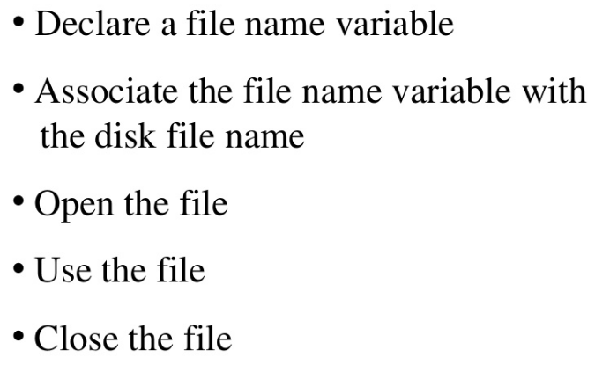
General File I/O Steps

Slide 9
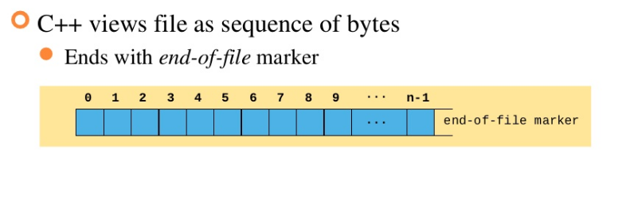
Files and Streams

Slide 10
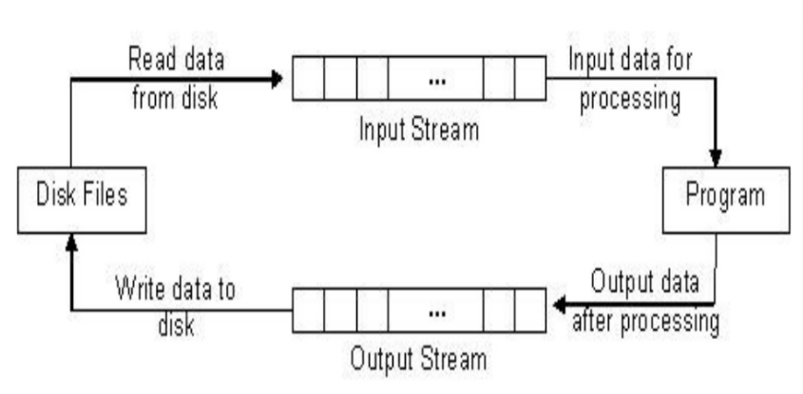
File Input and Output Streams

Slide 11
Stream Classes, Formatted Console I/O Stream

Slide 12
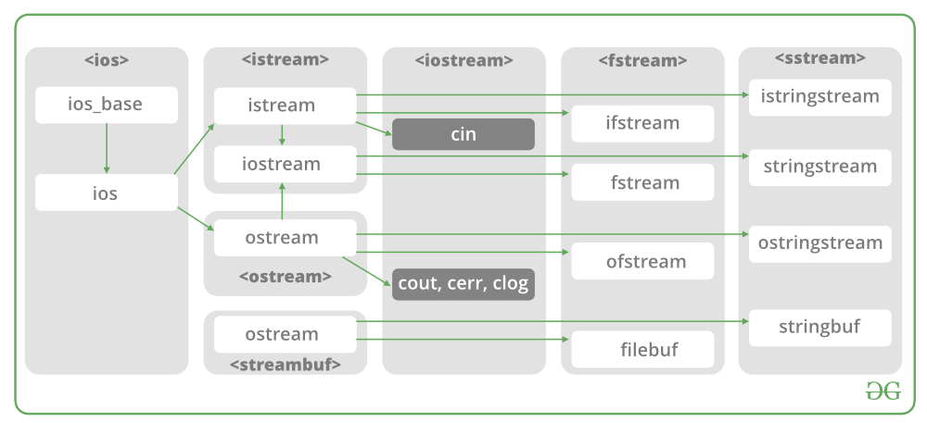
Classes for File stream operations

Slide 13
C++ Stream Classes
General I /O stream class
ios
Input stream class
Pointer
Output stream class
istream
streambuf
ostream
input
output
iostream

Slide 14
1. ios:-
ios stands for input output stream.
This class is the base class for other classes in this class hierarchy.
This class contains the necessary facilities that are used by all the other derived classes for input and output operations
2. istream:-
istream stands for input stream.
This class is derived from the class ‘ios’.
This class handle input stream.
The extraction operator(>>) is overloaded in this class to handle input streams from files to the program execution.
This class declares input functions such as get(), getline() and read().

Slide 15
3.ostream:-
ostream stands for output stream.
This class is derived from the class ‘ios’.
This class handle output stream.
The insertion operator(<<) is overloaded in this class to handle output streams to files from the program execution.
This class declares output functions such as put() and write().
4. streambuf:-
This class contains a pointer which points to the buffer which is used to manage the input and output streams.
5. fstreambase:-
This class provides operations common to the file streams. Serves as a base for fstream, ifstream and ofstream class.
This class contains open() and close() function.

Slide 16
6. ifstream:-
This class provides input operations.
It contains open() function with default input mode.
Inherits the functions get(), getline(), read(), seekg() and tellg() functions from the istream.
7. ofstream:-
This class provides output operations.
It contains open() function with default output mode.
Inherits the functions put(), write(), seekp() and tellp() functions from the ostream.
8. fstream:-
This class provides support for simultaneous input and output operations.
Inherits all the functions from istream and ostream classes through iostream.
9. filebuf:-
Its purpose is to set the file buffers to read and write.
We can also use file buffer member function to determine the length of the file.

Slide 17
In C++, files are mainly dealt by using three classes fstream, ifstream, ofstream available in fstream headerfile. ofstream: Stream class to write on files ifstream: Stream class to read from files fstream: Stream class to both read and write from/to files.

Slide 18
File Operations in C++
C++ provides us with four different operations for file handling. They are:
open() – This is used to create a file.
read() – This is used to read the data from the file.
write() – This is used to write new data to file.
close() – This is used to close the file.

Slide 19
Opening files in C++
To read or enter data to a file, we need to open it first. This can be performed with the help of ‘ifstream’ for reading and ‘fstream’ or ‘ofstream’ for writing or appending to the file.
All these three objects have open() function pre-built in them.
Syntax:
open( FileName , Mode );

Slide 20
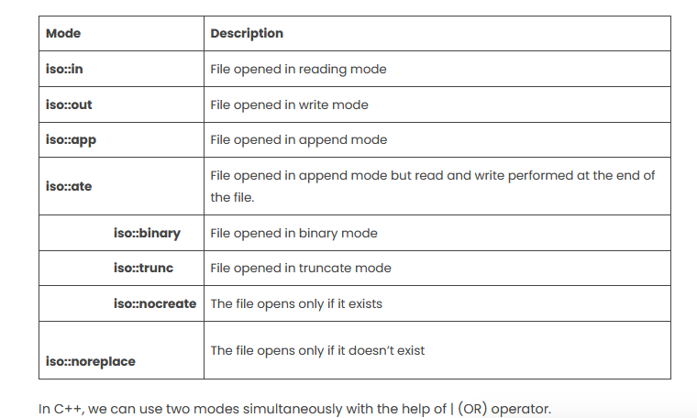

Slide 21
Program for Opening File:
#include<iostream>
#include<fstream>
using namespace std;
int main(){
fstream FileName;
FileName.open("FileName", ios::out);
if (!FileName){
cout<<"Error while creating the file";
}
else{
cout<<"File created successfully";
FileName.close();
}
return 0;
}
//On the above-created object, we have to apply the open() function to create a new file, and the mode is set to ‘out’ which will allow us to write into the file.
Output
File created successfully

Slide 22
Example : Writing to File
To write data to file which we created before.
We need to use fstream or ofstream object to write data into the file and to do so; we will use stream insertion operator (<<) along with the text enclosed within the double-quotes.
With the help of open() function, we will create a new file named ‘FileName’(or any other) and then we will set the mode to ‘ios::out’ as we have to write the data to file.
Syntax:
FileName<<"Insert the text here";

Slide 23
Program for Writing to File:
#include<iostream>
#include<fstream>
using namespace std;
int main() {
fstream FileName;
FileName.open("FileName.txt", ios::out);
if (!FileName) {
cout<<" Error while creating the file ";
}
else {
cout<<"File created and data got written to file";
FileName<<"This is a blog posted on Great Learning";
FileName.close();
}
return 0;
}

Slide 24
Reading from file in C++
Syntax:
FileName>>Variable;

Slide 25
#include<iostream>
#include <fstream>
using namespace std;
int main() {
fstream FileName;
FileName.open("FileName.txt", ios::in);
if (!FileName) {
cout<<"File doesn’t exist.";
}
else {
char x;
while (1) {
FileName>>x;
if(FileName.eof())
break;
cout<<x;
}
}
FileName.close();
return 0;
}

Slide 26
Lets Start
First step to open the particular file for read or write operation. We can open file by 1. passing file name in constructor at the time of object creation 2. using the open method
For e.g.
Open File by using constructor ifstream (const char* filename, ios_base::openmode mode = ios_base::in); ifstream fin(filename, openmode) by default openmode = ios::in ifstream fin(“filename”);
Open File by using open method Calling of default constructor ifstream fin; fin.open(filename, openmode) fin.open(“filename”);

Slide 27
Question: To read and write a File in C++
Input : Welcome to the department of Computer Engineering
Output : Welcome to the department of Computer Engineering

Slide 28
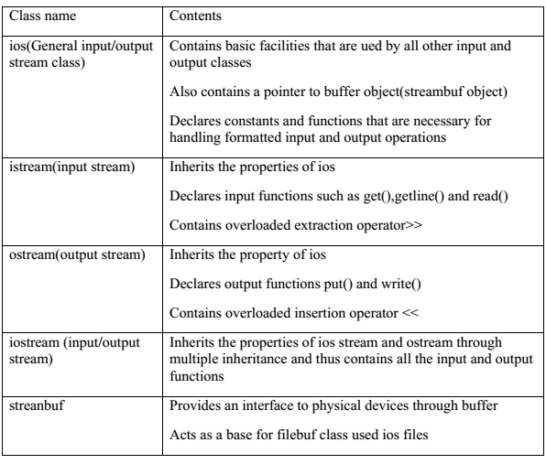
Streams classes for console operation

Slide 29
Formatted Console I/O Stream
The features are
ios class functions and flags
Manipulators User-defined output functions
User-defined output functions

Slide 30
ios class function
Function | Task
width() | To specify the required size for displaying an output value
precision() | To specify the number of digits to be displayed after the decimal point of a float value
fill() | To specify a character that is used to fill the unused portion of a field
setf() | To specify format flags that can control the form of output display
unsetf() | To clear the flags specified

Slide 31
width()
The width of the field to be used while displaying the output. Since it is a member function, it has to be invoked on an object
Syntax: cout.width(w);
Where w is the filed width
For example, the statements
cout.width(7);
cout<<543<<12<<“\n”;
will produce the following output
5
4
3
1
2

Slide 32
Setting Precision: precision()
By default, floating numbers are printed with six digits after decimal point.
However, we can specify the number of digits to be displayed after the decimal point
Syntax: cout.precision(d);
Example: cout.precision(2);
cout<<1.347<<endl;
1
3

Slide 33
Filling and Padding: fill()
To fill the unused positions by any desired character.
Syntax: cout.fill(ch);
where, ch represents the character which is used for filling the unused position
Example:
cout.fill(‘*’);
cout.width(10);
cout<<5250<<“\n”;
*
*
*
*
*
*
5
2
5
0

Slide 34
istream class
The istream class, which is derived from ios, performs input-specific activities, or extraction
Disk file
Destination
Source
OUTPUT
insertion
<<
put()
write()
INPUT
extraction >>
get()
read()
ostream
istream
Program

Slide 35
istream functions
Function | Purpose
>> | Formatted extraction for all basic (and overloaded) types
get(ch); | Extract one character into ch
get(str) | Extract characters into array str, until ‘\n’

Slide 36
Stream classes and errors

Slide 37
ostream class
The ostream class handles output or insertion activities
ostream functions
Function | Purpose
<< | Formatted insertion for all basic (and overloaded) types
put(ch) | Insert character ch into stream
flush() | Flush buffer contents and insert newline
write(str, SIZE) | Insert SIZE characters from array str into file

Slide 38
Reading the strings with getline()
int main(){
int size=20;
char city[20];
cout<<"enter the city name: \n";
cin.getline(city,size);
cout<<"New city name is: "<<city<<"\n\n";
}
INPUT 1:
enter the city name:
New Delhi
New city name is: New Delhi

Slide 39
Displaying String with write()
int main(){
char *str=“Programming”;
int n=strlen(str);
for(int i=1;i<=n;i++)
{
cout.write(str, i);
cout<<“\n”;
}
return 0;
}
Output
P
Pr
Pro Prog Progr Progra Program Programm Programmi Programmin Programming

Slide 40
Standard Error Stream
cerr is object of ostream class
It is attached to standard error device
Object cerr is unbuffered
cerr is also used to with << put operator

Slide 41
Manipulator
Manipulators are special functions that can be included in the I/O statements to alter the format parameters of a stream
To access manipulator, the file<iomanip> should be included in the program

Slide 42
ios Manipulators with Arguments
Manipulator | Argument | Purpose
setw() | field width (int) | Set field width for output
setfill() | fill character (int) | Set fill character for output
setprecision() | precision (int) | Set precision
setiosflags() | formatting flags (long) | Set specified flags
resetiosflags() | formatting flags (long) | Clear specified flags
endl | “\n” | Insert newline and flush stream

Slide 43
Stream Errors
The stream error-status flags constitute an ios enum member that reports errors that occurred in an input or output operation
Error Status Flag
Name | Meaning
goodbit | No errors (no flags set, value = 0)
eofbit | Reached end of file
failbit | Operation failed (user error, premature EOF)
badbit | Invalid operation (no associated streambuf)
hardfail | Unrecoverable error

Slide 44
Functions for Error Flags
Function | Purpose
int = eof(); | Returns true if EOF flag set
int = fail(); | Returns true if failbit or badbit or hardfail flag set
int = bad(); | Returns true if badbit or hardfail flag set
int = good(); | Returns true if everything OK; no flags set
clear(int=0); | With no argument, clears all unused bit error bits; otherwise sets specified flags, as in clear(ios::failbit)
Unused bits
eofbit 0x01
failbit 0x02
badbit 0x03
hardbit 0x04

Slide 45
Unit IV Files and Streams - File Stream Classes for File Operation

Slide 46
File Stream Classes for File Operation
ios
istream
streambuf
ostream
iostream file
iostream
ifstream
fstream
ofstream
filebuf
fstream file
fstream base

Slide 47
File Stream Classes
Sr. No. | Class | Contents
1 | fstreambase | provide operations common to the file streams contains open() and close() functions
2 | ifstream | provides input operations contains open() with default input mode Inherits get(), getline(), read(), seekg() and tellg() functions from istream
3 | ofstream | provides output operations contains open() with default output mode Inherits put(), seekp(), tellp() and write() functions from ostream
4 | fstream | Provides support for simultaneous input and output operations inherits all the functions from istream, ostream and iostream

Slide 48
File Handling Steps
1.Open/ Create a File
2.Read/ Write a File
3.Close File

Slide 49
Create and Write File(Output)
Create object of ofstream class
◦ofstream outfile;
Call open() function using ofstream object to open a file
◦outfile.open(“sample.txt”)
Write content in file using ofstream object
◦outfile<<name;
Call close() function using ofstream object to close file
◦outfile.close();

Slide 50
Open and Read File(Input)
Create object of ifstream class
◦ifstream infile;
Call open() function using ifstream object to open a file
◦infile.open ("sample.txt");
Read content in file using ifstream object
◦infile >> name;
Call close() function using ifstream object to close file
◦infile.close();

Slide 51
File opening
#include <iostream>
#include <fstream>
using namespace std;
int main ()
{
ofstream outfile;
char name[10];
outfile.open("sample.txt");
cout<<"enter name";
cin>>name;
outfile <<name;
outfile.close();
return 0;
}
#include <iostream>
#include <fstream>
using namespace std;
int main ()
{
ifstream infile;
char name[10];
infile.open ("sample.txt");
infile >> name;
cout<<name;
infile.close();
return 0;
}

Slide 52
open(): File modes
Syntax:
stream-object.open(“filename”, mode);
By default ofstream opens file for writing only
By default ifstream opens file for reading only
Three ways to create a file
1.ofstream send(“abc.txt”); //constructor
2.ofstream send; //open() function
send.open(“abc.txt”);
3.oftsream send; //open() function with mode
4.send.open(“abc.txt”, ios:: out);

Slide 53
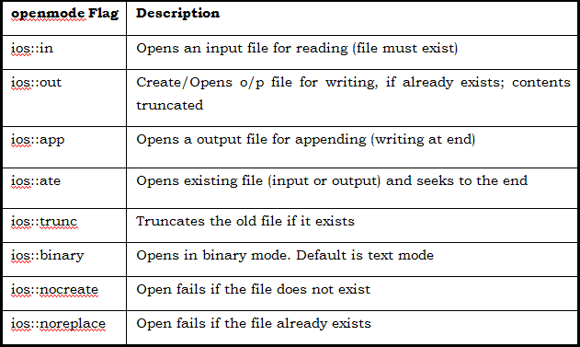
File opening modes

Slide 54
Detecting end of file
eof() is a member function of ios class. It returns a non-zero value if end-of-file condition is encountered and zero otherwise. Hence the above statement terminates the program on reaching the end of file.
If (fin.eof() !=0) { exit 1; }

Slide 55
References
E Balagurusamy Object-Oriented Programming with C++.7th edition.McGraw-Hill Publication, ISBN 10: 9352607996 ISBN 13: 9789352607990
Robert Lafore, ― Object-Oriented Programming in C++‖, fourth edition, Sams Publishing, ISBN:0672323087 (ISBN 13: 9780672323089

Slide 56
Unit IV Files and Streams - File Pointer and Error Handling in File I/O

Slide 57
FILE POINTERS
Each file object has two integer values associated with it :
get pointer
put pointer
These values specify the byte number in the file where reading or writing will take place.

Slide 58
File pointers…..
By default reading pointer is set at the beginning and writing pointer is set at the end (when you open file in ios::app mode)
There are times when you must take control of the file pointers yourself so that you can read from and write to an arbitrary location in the file.

Slide 59
Functions associated with file pointers :
The seekg() and tellg() functions allow you to set and examine the get pointer.
The seekp() and tellp() functions allow you to set and examine the put pointer.

Slide 60
seekg() function :
With one argument :
seekg(k) where k is absolute position from the beginning. The start of the file is byte 0
File
End
Begin
k bytes
^
File pointer
The seekg() function with one argument

Slide 61
seekg() function :
With two arguments :
the first argument represents an offset from a particular location in the file.
the second specifies the location from which the offset is measured.
Begin End
^
Offset from Begin
The seekg() function with two argument

Slide 62
seekg() function :
With two arguments :
Begin
End
^
Offset from Begin
^
Offset from end
^
Offset from current
position
The seekg() function with two argument

Slide 63
Random access files
There are two pointers
Get pointer in input stream – seekg(),tellg()
Put pointer in output stream- seekp(),tellp()
Two functions to move this pointers
seekg() function moves the associated file's current get pointer offset number of characters from the specified origin
ios::beg Beginning-of-file
ios::cur Current location
ios::end End-of-file

Slide 64
Functions for Manipulations of File Pointers
seekg( ) 🡪 Moves get pointer (input) to a specified location.
seekp( ) 🡪 Moves put pointer(output) to a specified location.
tellg( ) 🡪 Gives the current position of the get pointer.
tellp( ) 🡪 Gives the current position of the put pointer.

Slide 65
The seekp() function moves the associated file's current put pointer offset number of characters from the specified origin
tellg() and tellp() gives the current position of the get and put pointer
fout.seekg(0, ios : : beg); | Go to start
fout.seekg(0, ios : : cur); | Stay at the current position
fout.seekg(0, ios : : end); | Go to the end of file
fout.seekg(m, ios : : beg); | Move to (m+1)th byte in the file
fout.seekg(m, ios : : cur); | Go forward by m bytes from the current position
fout.seekg(-m, ios : : cur); | Go backward by m bytes from the current position
fout.seekg(-m, ios : : end) | Go backward by m bytes from the end

Slide 66
Error Handling During File Operations
A file which we are attempting to open for reading does not exist.
The file name used for a new file may already exist.
We may attempt an invalid operation such as reading past the end-of-file.
There may not be any space in the disk for storing more data.
We may use an invalid file name.
We may attempt to perform an operation when the file is not opened for that purpose.

Slide 67
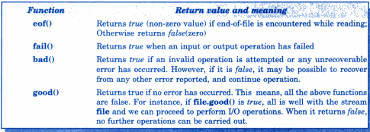
Error handling
If( fin.bad() ) //fin.good()
{
//report error
}
While(!fin.eof()) //!fin.fail()
{
}

Slide 68
Thank You!!

Slide 69
Overloading Cin and Cout, Memory Stream Objects and command line argument

Slide 70
Content
Overloading the extraction and insertion operator
Memory stream objects
Command line argument

Slide 71
Overloading the extraction and insertion operator
When we develop our own data types, we can overload the extraction operator(>>) and the insertion operator (<<) to work with our new data types and with cin and cout
It is also possible to overcome them so that they can work with disk files

Slide 72
Overloading cin and cout
Overloading the two operators is done in similar fashion
The operators take two parameters, passed by reference,
cin istream& operator >> (istream& s, Distance& d)
The overloaded operator takes input from the operator s and puts it in the member data d
In this example, s is a reference for cin and d is a reference for a variable of type Distance

Slide 73
Overloading cin and cout
cout ostream& operator << (ostream& s, Distance& d)
This overloaded operator takes input from the member data d and places it on the output stream s. In this example, s is a reference for cout and d is a reference for a variable of type Distance
The operator << () and operator >>() functions must be friends of the Distance class, since the istream and ostream objects appear on the left side of the operator

Slide 74
Overloading for cout and cin
class Distance {
private:
int feet;
float inches;
public: Distance() //constructor (no args)
{feet = 0; inches=0.0; }
Distance(int ft, float in)
{feet =ft; inches=in;}
friend istream& operator >> (istream& s, Distance& d);
friend ostream& operator << (ostream& s, Distance& d);
};
istream& operator >> (istream& s, Distance& d)
//get Distance from user
{
cout << “\nEnter feet: “; s >> d.feet; //using
cout << “Enter inches: “; s >> d.inches; //overloaded
return s; //>> operator
}
ostream& operator << (ostream& s, Distance& d) //display distance
{
s << d.feet << “\’-” << d.inches << ‘\”’;
return s;
}
int main()
{
Distance dist1, dist2; //define Distances
Distance dist3(11, 6.25); //define, initialize dist3
cout << “\nEnter two Distance values:”;
cin >> dist1 >> dist2; //get values from user display distances
cout << “\ndist1 = “ << dist1 << “\ndist2 = “ << dist2;
cout << “\ndist3 = “ << dist3 << endl;
return 0;
}
Output
Enter feet: 10
Enter inches: 3.5
Enter feet: 12
Enter inches: 6
dist1 = 10’-3.5”
dist2 = 12’-6”
dist3 = 11’-6.25”

Slide 75
Memory as a Stream Object
We can treat a part of memory as a stream object and insert data into it in same way as it is in a file. This is called In-memory Formatting
Example: when calling output functions in a GUI environment such as Windows, since these functions often require a string as an argument
A family of stream classes implements such in-memory formatting
For output to memory there is ostrstream, which is derived from (among other classes) ostream. For input from memory there is istrstream, derived from istream; and for memory objects that do both input and output there is strstream, derived from iostream

Slide 76
Memory as a Stream Object
#include<strstream>
#include <iostream>
#include<iomanip>
using namespace std;
const int SIZE = 80; //size of memory buffer
int main(){
char ch = 'x'; //test data
int j = 77;
double d = 67890.12345;
char str1[] = "Hello";
char str2[] = "world";
char membuff[SIZE]; //buffer in memory
ostrstream omem(membuff, SIZE); //create stream object
omem << "ch=" << ch << endl
<< "j=" << j << endl
<< setiosflags(ios::fixed) //format with decimal point
<< setprecision(2) //two digits to right of dec
<< "d=" << d << endl<< "str1=" << str1 << endl<< "str2=" << str2 << endl<< ends; //end the buffer with ‘\0’
cout << membuff; //display the memory buffer
return 0;
}
Output
ch=x
j=77
d=67890.12
str1=Hello
str2=world

Slide 77
Command Line Argument and Printer Output

Slide 78
Command line arguments
When executing a program in either C or C++ there is a way to pass command line arguments.
Used to pass name to data files
Each parameter separated by a space
The first argument is always the filename and second argument contains the program to be executed
int main(int argc, char *argv[])
Comes into the program as two arguments
argc – Number of parameters
argv – Parameter list

Slide 79
Program
int main(int argc, char *argv[])
{
cout << "argc=" << argc << endl;
for(int i=1;i<argc;i++)
cout<<“\t”<<argv[i]<“ ”;
cout<<“!”<<endl;
return 0;
}
Output
unix@unix-HP-280-G4-MT-Business-PC:~$ g++ prog1.c++ -o exe_1
unix@unix-HP-280-G4-MT-Business-PC:~$ ./exe_1 Hello World
Hello World !
unix@unix-HP-280-G4-MT-Business-PC:~$

Slide 80
Printer output
C++ printerstream is a simple template extension of the standard C++ output stream
#include”printerstream.h”
using namespace std;
int main(){
printerstream<wchar_t>printer(“PDFCreator”);
printer.margins(page_margins((printer.page_width()/100)*5));
printer.begin(“Test”);
printer<<“Hello world”;
printer.end();
return 0;
}

Slide 81
Read and write example
#include <fstream>
#include <iostream>
using namespace std;
int main () {
char data[100];
// open a file in write mode.
ofstream outfile;
outfile.open("afile.dat");
cout << "Writing to the file" << endl;
cout << "Enter your name: ";
cin.getline(data, 100);
// write inputted data into the file.
outfile << data << endl;
cout << "Enter your age: ";
cin >> data;
cin.ignore();
// again write inputted data into the file.
outfile << data << endl;
// close the opened file.
outfile.close();
// open a file in read mode.
ifstream infile;
infile.open("afile.dat");
cout << "Reading from the file" << endl;
infile >> data;
// write the data at the screen.
cout << data << endl;
// again read the data from the file and display it.
infile >> data;
cout << data << endl;
// close the opened file.
infile.close();
return 0;
}

